Slide 1

Square wave to sine wave converter
By Samoilă Ciprian

Slide 2
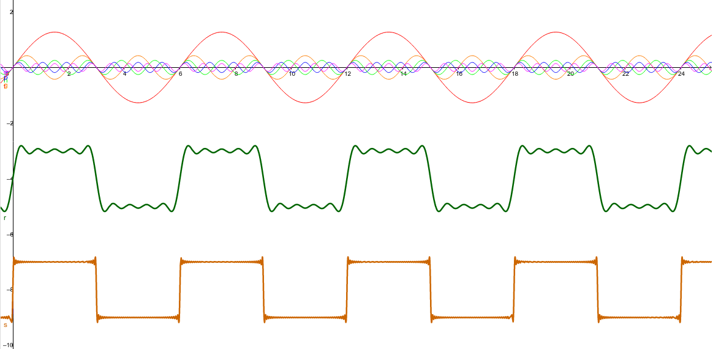

Slide 3
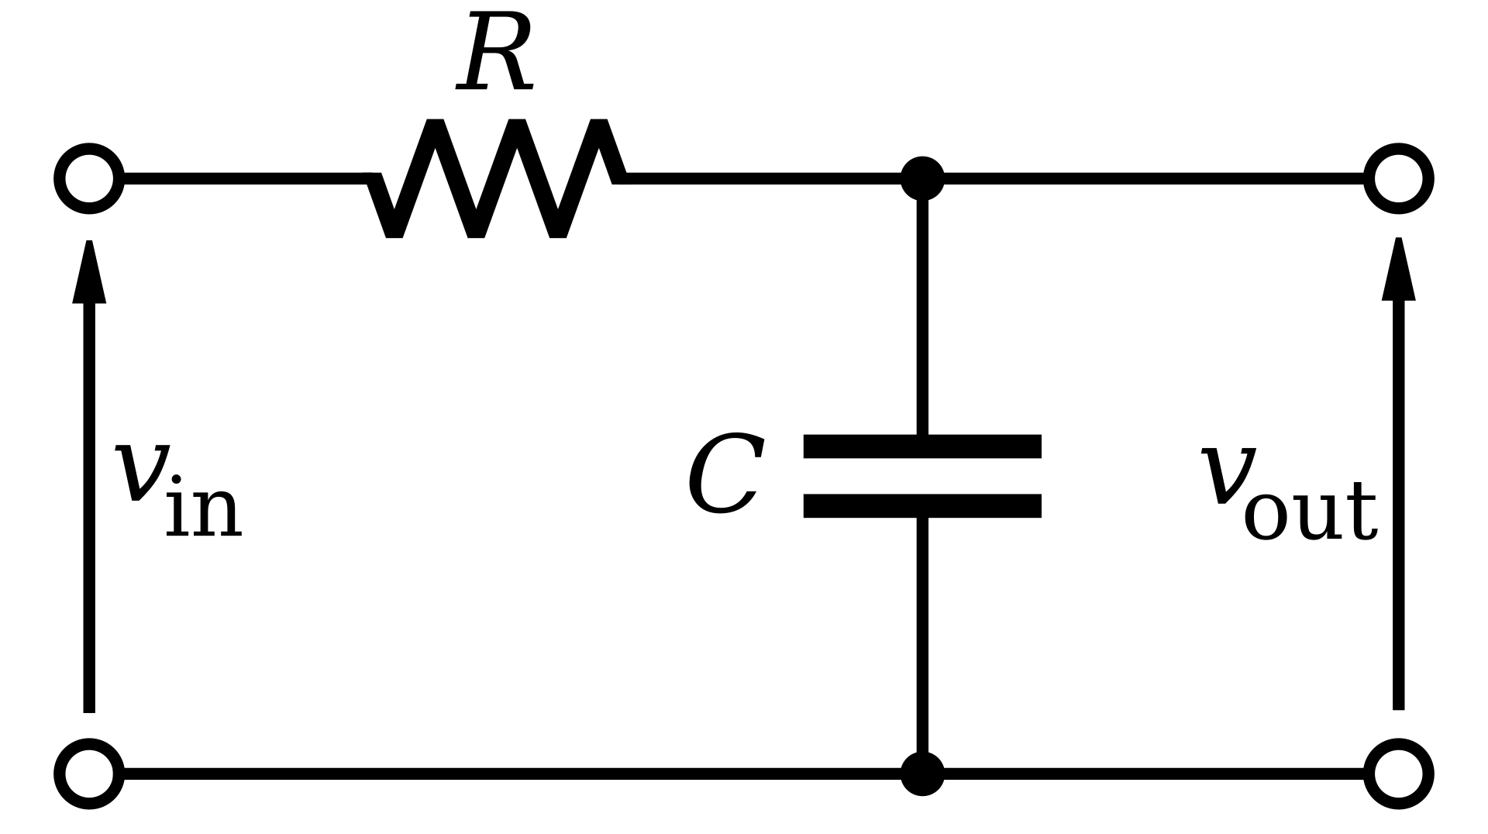
Low-pass filter
Filters out the high frequency waves
Only low frequency signals can pass
In fact, it attenuates more the high frequency signals than the low frequency ones
All signals are attenuated to some extent!

Slide 4
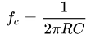
The cutoff frequency
The point where the signal begins to be attenuated rather than passing through
I chose the cutoff frecuency to be equal to the frequency of the square wave
So f = 0.5 Hz
C = 10 uF
From the formula, R must be 31 Kohms
If the cutoff frequency is higher, the output wave has a greater amplitude, but is more noisy (the high frequency signals being les attenuated too)

Slide 5
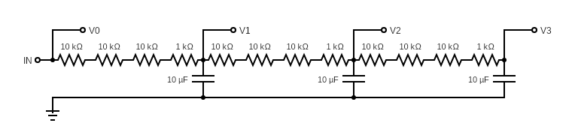
The breadboard
I chose to connect in series three such filters, for a more precise result
For the resistance (31K) i connected in series 3 x 10K and 1 x 1K

Slide 6
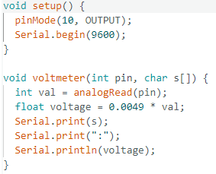
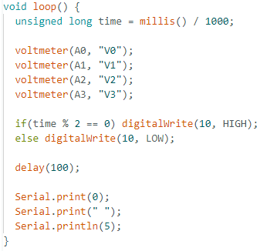
The code
Time counts the seconds from the start of the program
The period of the input signal is two seconds
The volmeter function prints the result in the range 0V -> 5V
There are 10 readings per second

Slide 7
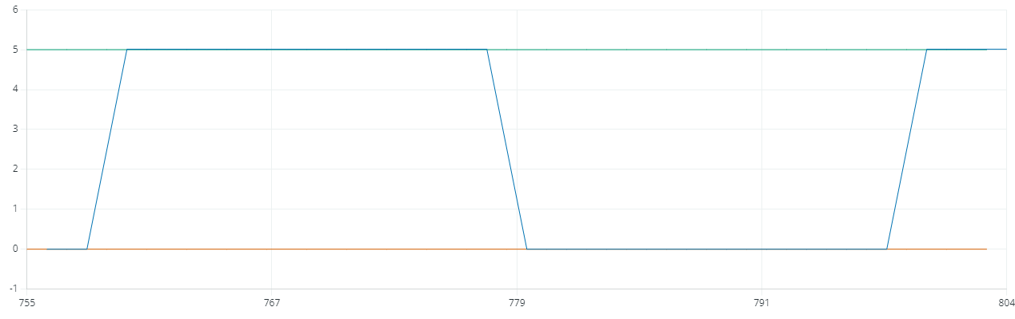
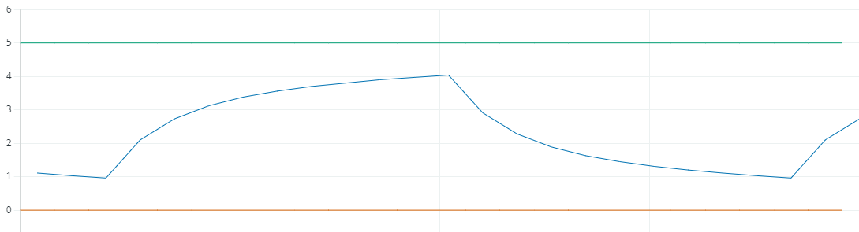
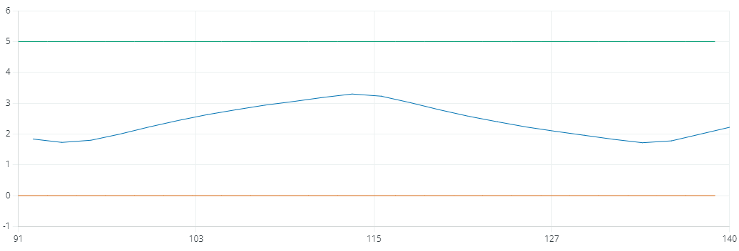
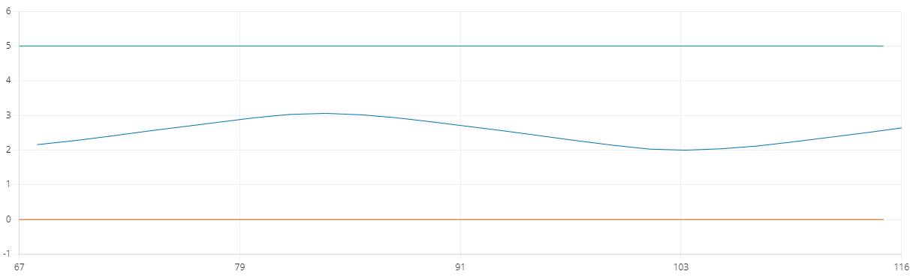
The result
V0
V1
V2
The shape of the output voltage is indeed very similar to a sine wave, but the amplitude is smaller
V3

Slide 8

Thank you for your attention!

